Slide 1
Information Visualization Project Proposal and Dataset
G8-A
70969 – Mário Reis
75456 – Artur Fonseca
76046 – André Pires

Slide 2
INITIAL DATASET
01

Slide 3
Initial Dataset
Description
Our initial dataset was one file for each year (2007-2015) about unemployment from all the higher education courses registered in “Centro de Desemprego” and other file with entry grades of 2016 for all the higher education courses.
The files from 2007–2015 each one had different layouts and different tables in short they were a bit heterogeneous as seen in the following samples.

Slide 4
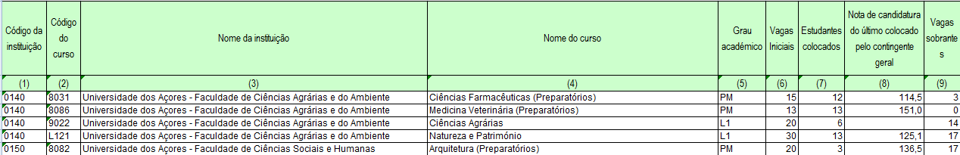
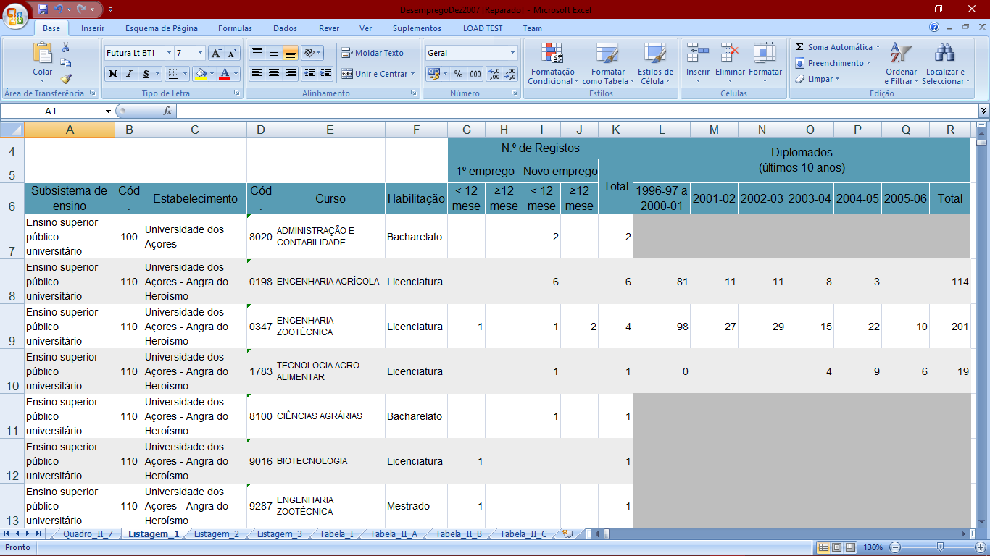
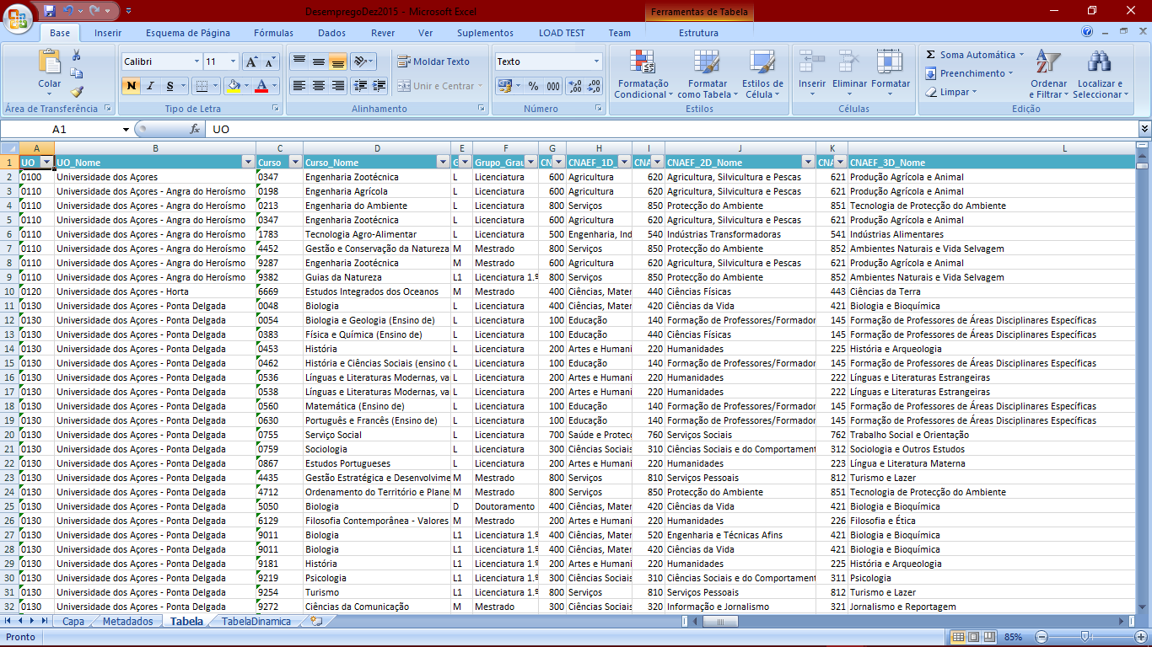
Initial Dataset
Data sample
(EntryGrades2016.xls)
(Courses2007.xls)
(Courses2015.xls)
Notes:
Note: This file is truncated because it has more than 50 columns/attributes.

Slide 5
Selected / derived data
02

Slide 6
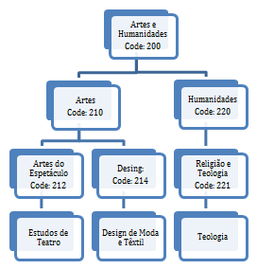
Selected data
Data description
We selected the following attributes: Year, Course Name, Course Code, University Name, University Code, Degree Level, Total Unemployed, Total Graduates, Course Area Code and Course Area Name
A little explanation about course areas, there are 3 hierarchical levels but top level has many roots “it is a forest of trees”, the image at right summarize the idea (Leaves are the courses).

Slide 7
Derived data
Derived data description
We calculated the following derived measures for each year:
% Unemployment By Course
(100 * Total Unemployed of Course/ Total Graduates of Course)
Task 1: Compare the unemployment (%) of different courses (regardless of course conclusion year of the graduates)
Task 2: Present the information about unemployment (%) from a specific course graduates across time.

Slide 8
Derived data
% Unemployment by Each University
(100 * Total Unemployed of University/ Total Graduates of University)
Task 3: Identify the university with more unemployment (%)
% Unemployment By Each Area Level
(100 * Total Unemployed of Area/ Total Graduates of Area)
Task 5: Summarize the employment/unemployment by graduation areas

Slide 9
Data abstraction
03

Slide 10
Data abstraction
Description:
Dataset type:

Slide 11
Data abstraction
Item1 description
Attribute1 description
Attribute2 description
Item2 description
Attribute1 description
Attribute2 description
…

Slide 12
Data abstraction
Semantics:

Slide 13
Dataset processing
04

Slide 14
Dataset processing
Dataset cleaning description
Entry1
Entry2
…

Slide 15
Dataset processing
Problems found:
Problem 1
Solution
Problem 2
Solution

Slide 16
Mapping
05

Slide 17
Mapping
Question 1
Data
Question 2
Data
…

